Slide 1
Measuring Ethereum’s Centrality and Use
Griffin Shaw

Slide 2
Outline
Motivation
Blockchain Refresher
Ethereum Refresher
Tools
Challenges
Cryptocurrency Analysis
Distributed Computing Analysis
Conclusions
Future Work

Slide 3
Motivations
Blockchains are often lauded as paradigms of decentralization.
How well do they fare in practice?
How does on-chain centrality affect network health?
How are people actually using Ethereum?
Can we find anything interesting?

Slide 4
Blockchain Refresher
Focus on distributed ledger technology (DLT)
A sequence of blocks “chained” together
Blocks contain transactions that change the state
Blocks contain the prior block’s hash ( “chaining”)
Accounts are public private key pairs
Blockchain networks are made up of nodes
Each node independently validates blocks
Nodes can participate in consensus (“mining”)

Slide 5
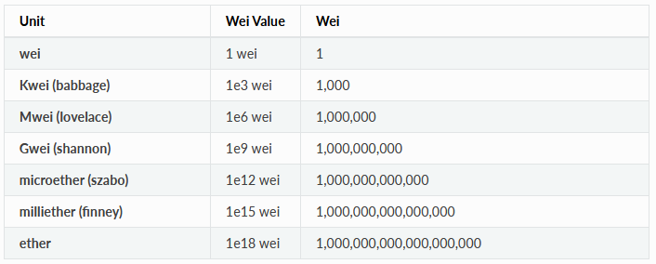
Ethereum: Refresher
Cryptocurrency: Ether
EVM: Ethereum Virtual Machine
Account-Balance based
Transaction Fees = gas * gas_price
gas – unitless, stabilizer
gas_price – ether, cost per gas
Nodes run a custom virtual machine
Stack based
Turing Complete*
Programs are “smart contracts”
EVM bytecode
Generally compiled from Solidity

Slide 6
Tools Overview
Blockchain Exporter
Ethereum ETL
SQL Database
Graphing And Analysis
Gephi
Geth
Archival Node
Google’s Big Query
Parity
Python
JavaScript

Slide 7
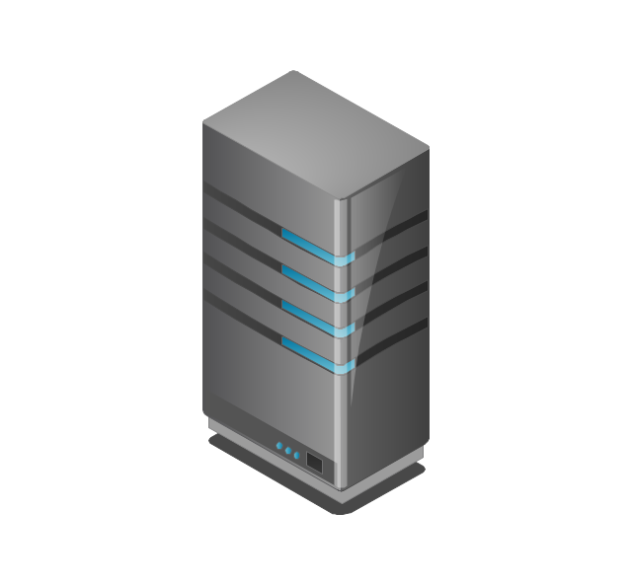

Challenge 1: Exporting The Blockchain
Syncing a full node can take several days
“Full nodes” contain a fully verified record
Not all data is immediately available
Requires ~250GB
Syncing an archival node can take up to a month!
“Archival Nodes” explicitly store the results of transactions
Data is immediately available
Requires ~4TB
SSD storage is required
HDDs are too slow
Sync will never catch up to new blocks

Slide 8

Solution 1: Leveraging Big Query
Google’s Big Query has an Ethereum dataset updated daily
They also use Ethereum-ETL
We continued to sync the archival node
Enables access to anything unavailable on Big Query
Took about a month

Slide 9
Challenge 2: Database Size
Table | Rows | Size
balances | 114,961,141 | 6.42 GB
blocks | 9,978,998 | 10.28 GB
contracts | 25,285,173 | 24.11 GB
logs | 622,040,255 | 299.61 GB
token_transfers | 386,838,359 | 111.71 GB
tokens | 178,995 | 28.72 MB
traces | 1,765,374,934 | 1,013.11 GB
transactions | 694,792,670 | 309.34 GB

Slide 10
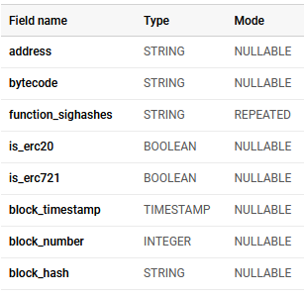

Solution: Pre-Processing
All Smart Contracts
Unique Fingerprints
24.11 GB
25,285,173 rows
887.68 MB
235,086 rows

Slide 11
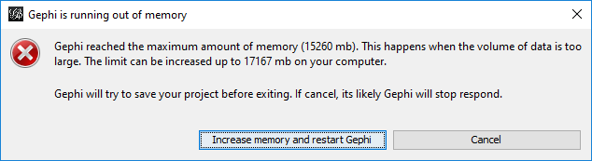
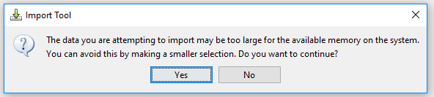
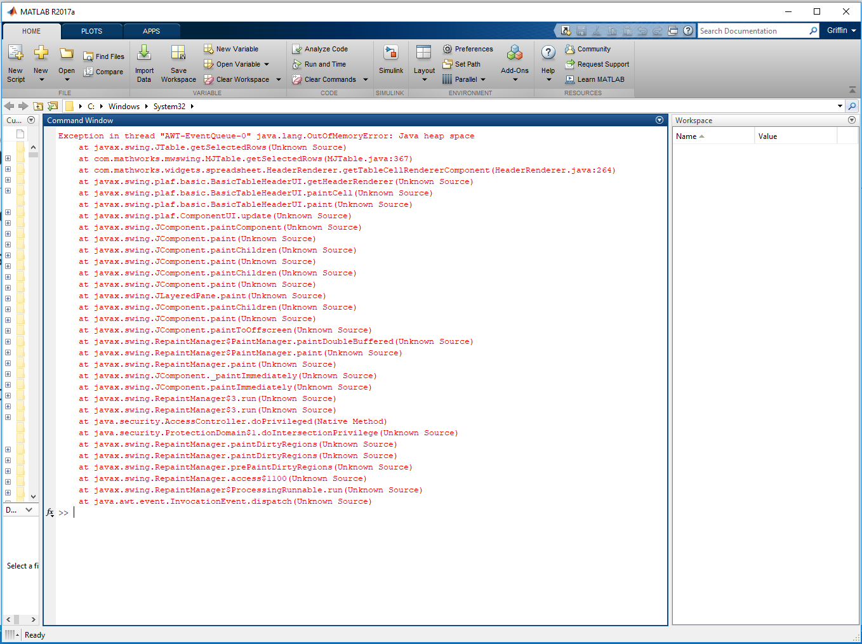
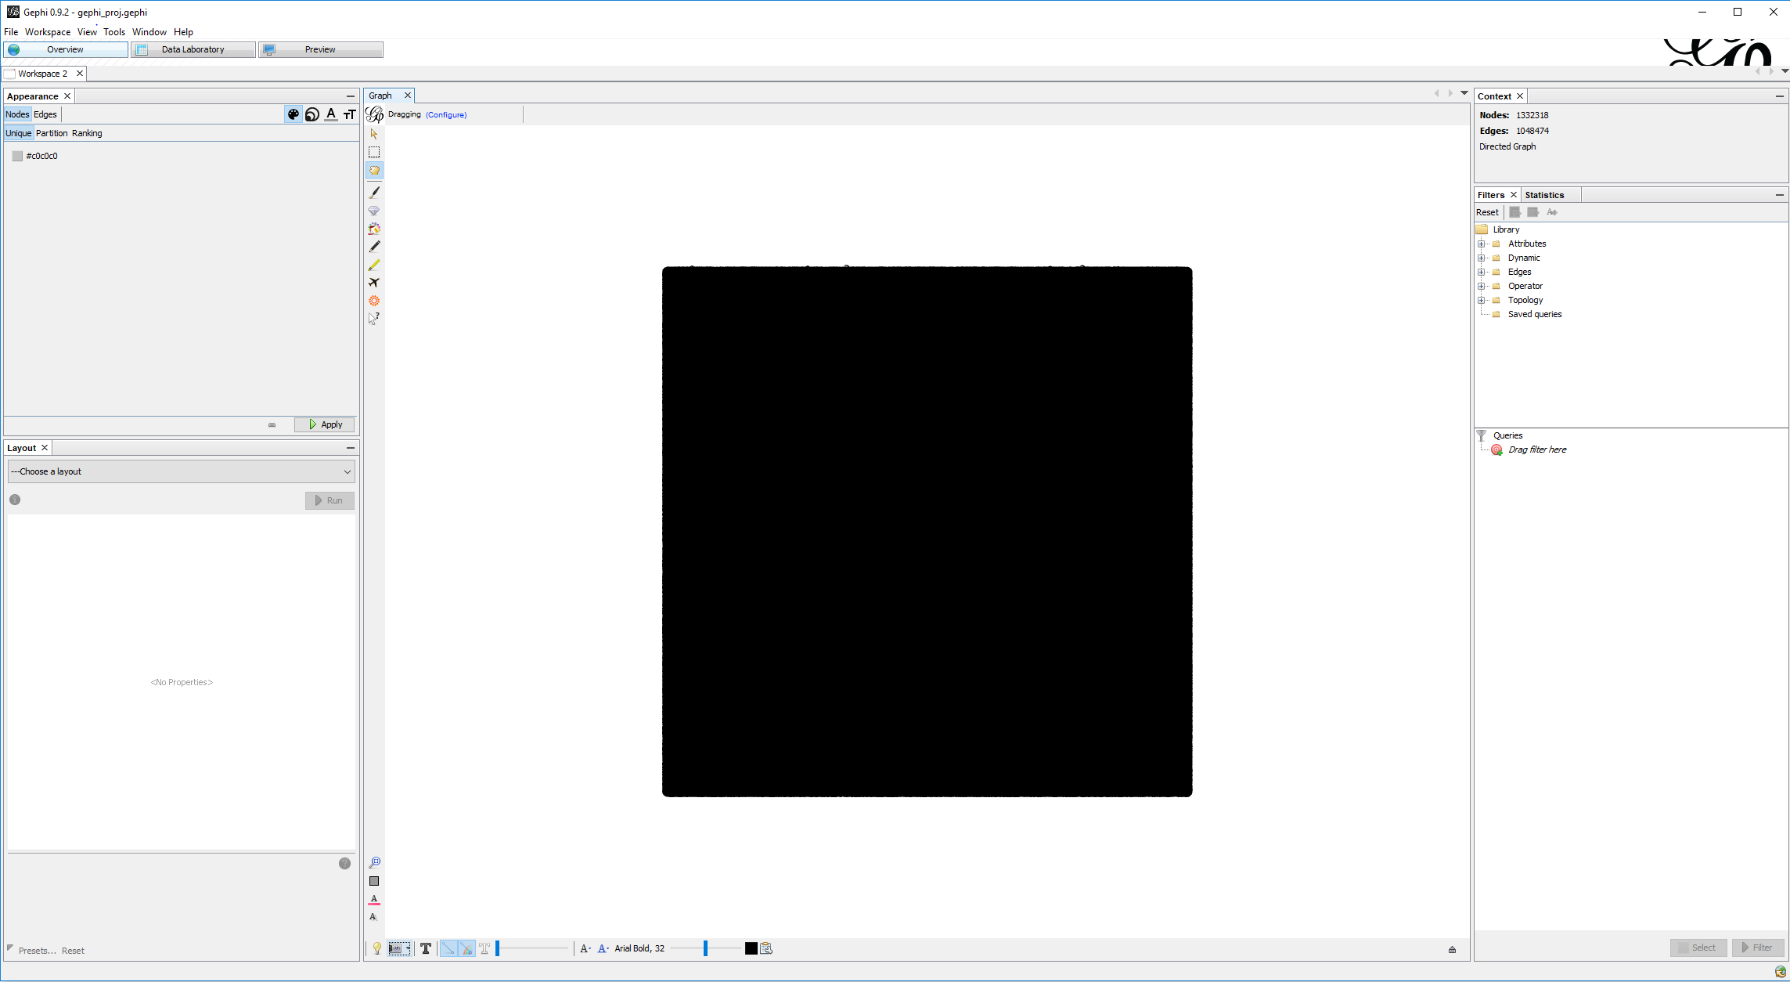
Challenge 3: Analysis Software

Slide 12
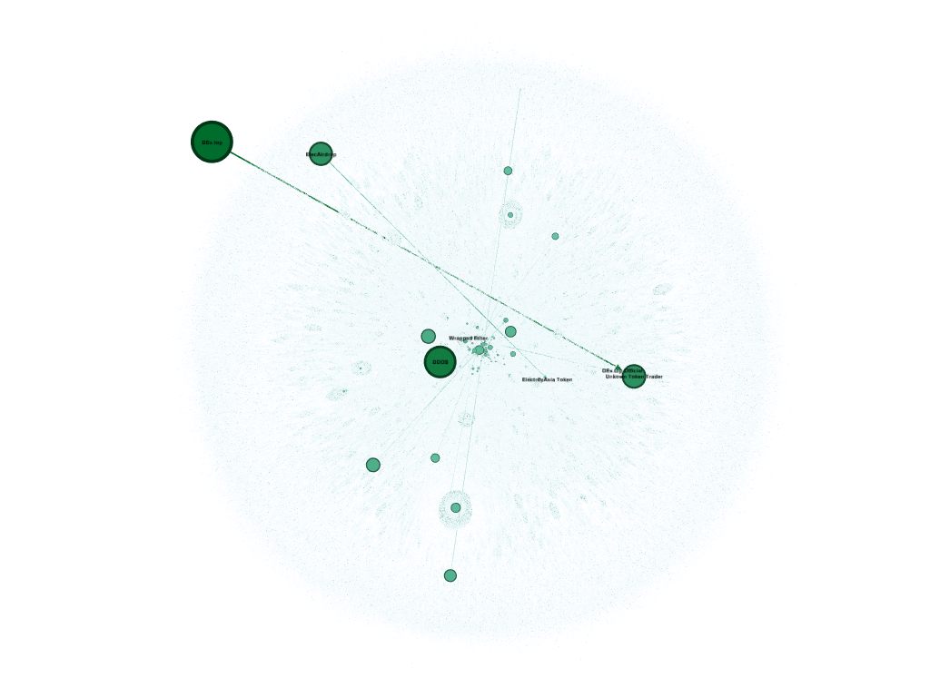

Solution 3: Scripting and Patience
Gephi
Requires hours to import and process
Still too large to export properly
Python
Can import any database
Only limited by RAM
Very Fast!
Gephi Screenshot
Failed Export

Slide 13
Cryptocurrency: Analysis of Wealth
SQL Queries
Balances
Export
Export as CSV
Analysis
Plot with Python
Transactions
Create Graph representation
Create New Tables
Measure statistics
Create adjacency graph

Slide 14
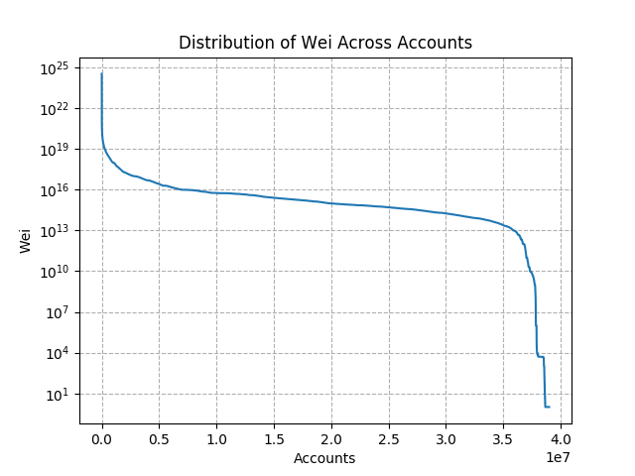
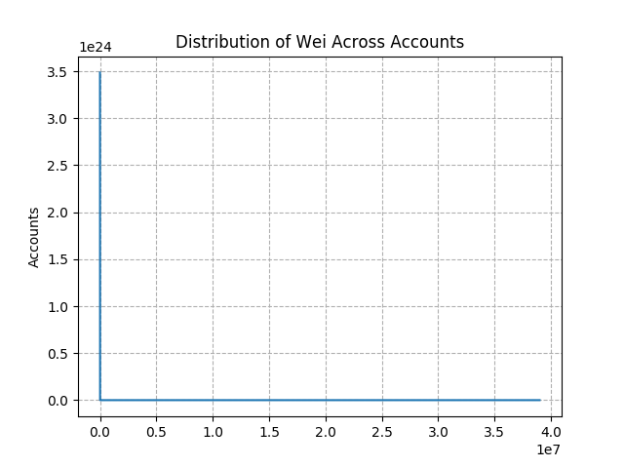
Overall Wealth Distribution
Account Balance Statistics
Mean Balance | 0.963 ETH
Maximum Balance | 3,486,573.188 ETH
Standard Deviation | 644.143 ETH
Coefficient of Variation | 668.892

Slide 15
Active Wealth: 2 Years of Transactions
Active Account | Dormant Account | Inactive Account
Has recently sent transactions | No transactions in past 2 years | No Transactions
Notes:
Most accounts are active!
Lots of wealth is tied up in inactive accounts. Potentially old money, lost money, or investors with steady hands.

Slide 16
Lost Wealth
Transaction Fee’s are not returned on failure
Only 2% of all transactions are failed
22,748 ETH has been lost
Currently $4,650,000
Most errors are avoidable
Gas requirements can be calculated

Slide 17
Account Participation
Account Adjacency Graph
Nodes are accounts
Edges are transactions between accounts
Edges are weighted by frequency
Nodes are sized by weighted degree
Manually researched top accounts
Many Exchanges
Some DDOS
Network Statistics
Average Degree | 0.787
Average Weighted Degree | 3.203
Network Diameter | 13

Slide 18
EVM: Distributed Computation Analysis
Smart Contract Similarity
Linked Library Use
How diverse is the pool of smart contracts?
Techniques and Tools:
Search for duplication
Fingerprint each smart contract
Smart contract linked libraries:
Save space
Save money
Can be reused
But are they actually in use?

Slide 19
Smart Contract Similarity
Check similarity using a fuzzy hashing technique:
Context triggered piecewise hashes (CTPH)
Smart contracts are good candidates for fuzzy hashing
Easily divided into separate logical components
Relative order of functions is deterministic
Pre-process Contracts
Reduce table down to unique bytecode
Remove Hardcoded Values
Ignore constant values
Segment Bytecode
End segments on:
Focus only on logic
Hash Segments
STOP
JUMP
JUMPI
RETURN
REVERT
Each segment is independently hashed
Combined to create the fingerprint

Slide 20
Code Duplication
Exact Duplication
Logical Duplication
Only 279,619 contracts have unique bytecode
1.1% of all deployed contracts
235,086 have unique fingerprints
0.9% of all deployed contracts
Exact Duplicates
Minimum Duplicates | 1
Maximum Duplicates | 5521159
Mean Duplicates | 90.42
Standard Deviation | 14077.95
Coefficient of Variation | 155.70
Logical Duplications
Minimum Duplicates | 1
Maximum Duplicates | 5618092
Mean Duplicates | 107.56
Standard Deviation | 15514.94
Coefficient of Variation | 144.24

Slide 21
Pairwise Similarity
Pairwise similarity of all contracts is infeasible.
Top 100 accounts by account balance are more similar than a random selection
Statistic | Top 100 Contracts | 1000 Random Contracts
Minimum Score | 47.82 | 26.56
Maximum Score | 100.0 | 100
Mean Score | 63.13 | 69.98
Standard Deviation | 11.09 | 16.41
Coefficient of Variation | 0.17 | 0.23

Slide 22
External Library Detection
Solidity provides the ability to use “external libraries”
Much like regular software libraries
Reside on chain as their own smart contracts
SafeMath is a common example
Easy to recognize
Linked during contract deployment
Always PUSH20 -> address -> function signature
Extract all addresses matching this pattern from contract bytecodes

Slide 23
Linked Library Utilization
Only 5,462 libraries deployed
0.02 % of all smart contracts
Linked Library Invocations
Minimum Invocations | 1
Maximum Invocations | 28,537,180
Mean Invocations | 28,738.33
Standard Deviation | 564,784.33
Coefficient of Variation | 19.65

Slide 24
Conclusions
Wealth centralized among a minority of accounts
Mostly for profit organizations
A vast majority of accounts are active
Though active accounts underrepresent in total wealth
Contributes to a healthy network
Most of the money lost in transactions could be avoided
Potential need for an application to calculate needed gas
Very few contracts are unique
Very hard to stop copycats
Linked Libraries are underused
Contributes to blockchain’s growth problem

Slide 25
Lessons and Future Work
Basically everything I know about smart contracts came from this project
I knew basically nothing about the EVM at the start
SQL is easy to learn but hard to master
Especially when efficiency is mandatory
Infinite number of rabbit holes to fall down while analyzing Ethereum
Potentially apply techniques to other blockchains

Slide 26
Acknowledgments
Dr. Ning Zhang for being my guide and advisor
Dr. Yang Xiao his remote support and collaboration
Zixuan Li for his partnership on this project

Slide 27
Questions
Thank you for listening!

